Slide 1



Paper ID : ICMSCI-1534
SHANJAY R K (927621BEC195)
SIVARAMAKRISHNAN M (927621BEC201)
SUBASH P (927621BEC213)
YASAR S (927621BEC245)
GUIDED BY :
Dr.K.SHEIKDAVOOD (AP/ECE)

Slide 2

Advanced short circuit preventive mechanism for Electric vehicles

Slide 3
Introduction
The growing adoption of electric vehicles (EVs) highlights critical challenges in ensuring the safety and reliability of their electrical systems.
Delayed Fault Detection: Traditional systems like fuses and relays react slowly, increasing damage risks.
Lack of Proactive Measures: Absence of predictive maintenance leads to unexpected failures and downtime.
System Vulnerabilities: Overheating, voltage fluctuations, and undetected ground faults compromise safety.
Scalability Limitations: Current solutions are not adaptable to evolving EV technologies or remote diagnostics

Slide 4


Project objectives
This project aims to revolutionize electrical safety in electric vehicles by developing an advanced short circuit preventive mechanism. By leveraging real-time monitoring, AI-based predictive analytics, and self-healing technology, the system enhances safety and ensures proactive risk mitigation. Focus on system reliability, energy efficiency, and scalability, this solution is designed to protect critical components, reduce downtime, and adapt seamlessly to future technological advancements, setting a new standard for sustainable and secure electric vehicle operations.

Slide 5

Existing Techniques
01
Fuse Protection
A fuse blows to prevent damage from
excessive current
02
Current Limiting Circuit
Limits current to protect sensitive
components
03
Electronic Safety Relays
Disconnect the power circuit during faults to protect electrical systems.
04
Ground Fault Detection
Monitors the system for unintended paths to ground, preventing potential short circuits or electrical hazards

Slide 6
Literature review
Author | Title | Year of published | Drawback
D. Qiao et al | "Quantitative Diagnosis of Internal Short Circuit for Lithium-Ion Batteries Using Relaxation Voltage" | 2024, IEEE Transactions on Industrial Electronics | Focuses primarily on diagnosis without providing real-time mitigation strategies for detected faults.
Z. Sun et al. | "An Online Data-Driven Fault Diagnosis and Thermal Runaway Early Warning for Electric Vehicle Batteries" | 2022, IEEE Transactions on Power Electronics | Limited to battery systems; lacks consideration of external factors like environmental conditions.
F. Kaya and O. Akar | "Short Circuit Effects on HV Feeders of Optimally Located Electric Vehicle Fast Charging Stations" | 2024, IEEE Access | Addresses stationary systems only; does not factor in dynamic or mobile EV charging scenarios.

Slide 7
Research Gap
Advanced techniques like data-driven fault diagnosis, thermal runaway warnings, and digitally adjustable short-circuit detection are critical for ensuring electric vehicle battery safety and power semiconductor reliability.
Short circuits in EV fast charging stations and electric drives require system-level optimization, including infrastructure degradation monitoring and efficient fault mitigation strategies.

Slide 8
Proposed Solution
Real-time Short Circuit Detection
Advanced Thermal and
Voltage Monitoring
1
4
Predictive Maintenance Algorithms
Self-Healing
Technology
2
5
Automated Circuit Isolation Mechanism
AI-Based Predictive Analytics
3
6

Slide 9
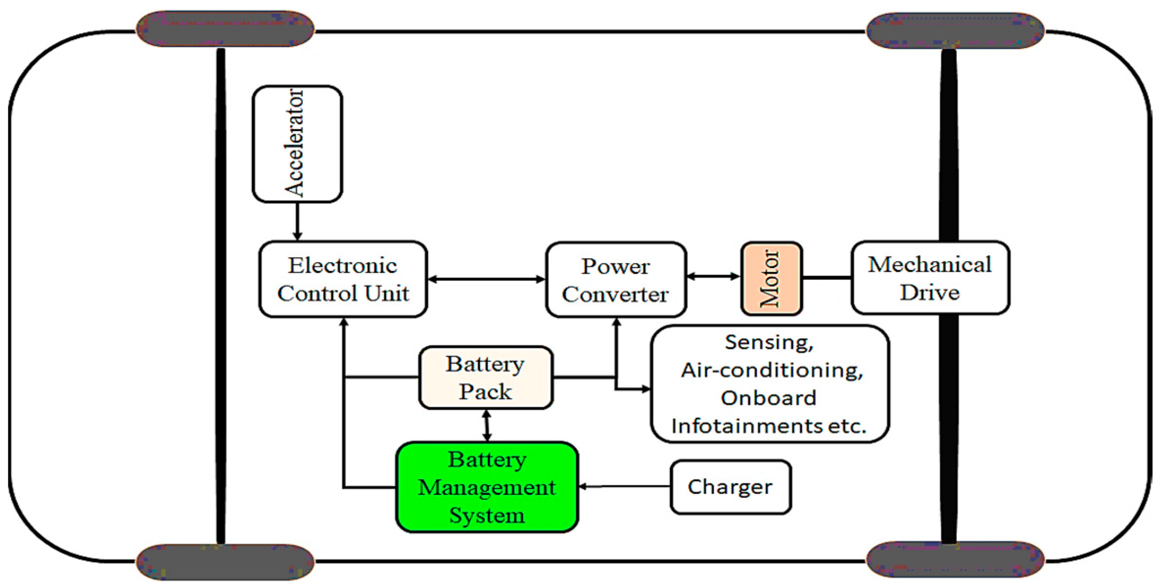
Block Diagram

Slide 10
Advantages of Proposed solution
Real-time detection allows quicker response to short circuits, minimizing damage.
AI-based predictive analytics enhance maintenance scheduling, reducing downtime.
Automated circuit isolation ensures rapid protection and system recovery without manual intervention.
Self-healing technology restores functionality by automatically correcting faults.
Wireless communication enables remote monitoring and instant updates for system health.
Advanced thermal and voltage monitoring optimizes performance and prevents overheating issues.

Slide 11
Result
Successfully implemented high-speed sensors with a Threshold-Based Anomaly Detection algorithm, achieving a fault detection accuracy of >95%.
Integrated Rule-Based Logic Control for immediate circuit isolation, reducing fault impact by 50%.
Leveraged Genetic Algorithms to restore circuit functionality post-fault, improving operational reliability.
Deployed LSTM Networks, providing actionable insights and optimizing overall system performance.

Slide 12
Conclusion
The proposed advanced short circuit preventive mechanism for electric vehicles enhances system reliability and safety through real-time detection, predictive maintenance, and automated fault isolation.
By integrating AI-based analytics, self-healing technology, and wireless communication, the system offers a robust solution to minimize risks, improve performance, and reduce downtime.
This innovative approach not only ensures better protection of critical components but also optimizes long-term operational efficiency, making it a significant advancement in the field of electric vehicle safety and management.

Slide 13
THANK YOU

